Slide 1
CNN
Amit Jha

Slide 2
Convolutional layer
Pooling layer
Neural Network

Slide 3
Convolutional Layer

Slide 4
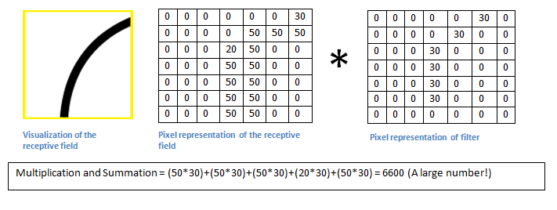

Slide 6
Pooling Layer

Slide 8
Neural Net

Slide 9
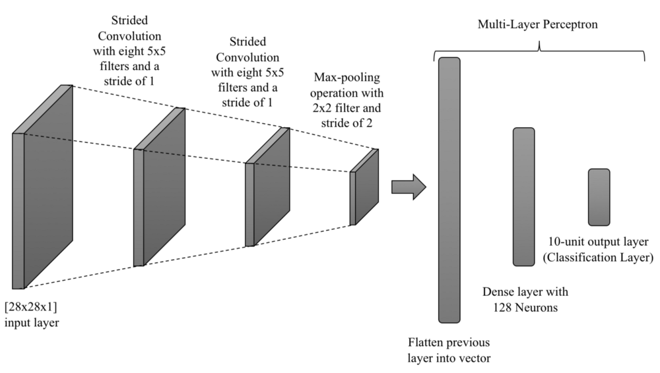

Slide 10
